Slide 1




Zorua: A Holistic Approach to Resource Virtualization in GPUs
Nandita Vijaykumar
Kevin Hsieh, Gennady Pekhimenko, Samira Khan,
Ashish Shrestha, Saugata Ghose, Adwait Jog, Phillip B. Gibbons, Onur Mutlu

Slide 2
Overview
Problem: Major on-chip resources in GPUs are managed by the programmer/software
Key Issues: Leads to several challenges in obtaining high performance:
Programming Ease: Requires programmer effort to optimize resource usage
Performance Portability: Optimizations do not port well across different GPUs
Resource Inefficiency: Underutilized resources even in optimized code
Our Goal:
Reduce dependence of performance on programmer-specified resource usage
Enhance resource efficiency for optimized code
Our Approach: Decouple the programmer-specified resource usage from the allocation in the hardware
Zorua: A Holistic Resource Virtualization Framework for GPUs
Key Results: Zorua enhances programming ease, performance portability and performance for optimized code

Slide 3


GPUs today are used across many classes of applications …
Computer Vision
Machine
Learning
Biomedical Imaging
Scientific
Simulation
GPU
. . .

Slide 4
On-Chip Resources in GPUs
Register File
Scratchpad
Memory
Compute Units
Thread Slots

Slide 5

Register File
Scratchpad
Memory
Every thread in a thread block needs to be allocated
enough (worst-case) resources to execute and complete
Thread Slots
Thread
Block
<#Threads,#Registers>
<#Threads,#Registers,Scratchpad(KB)>
<>
<#Threads>
Work
Group
Thread Slots

Slide 6
Abstraction of On-Chip Resources
Programmer/Software
<> per block
Tight coupling between
resource specification and allocation
<#Threads> per block
<#Threads,#Registers> per block
<#Threads,#Registers,Scratchpad(KB)> per block
Hardware
Scratchpad
Memory
Register File
Thread Slots

Slide 7
Key Issues
Static Underutilization
Dynamic Underutilization

Slide 8
1. Static Underutilization
<#Threads,#Registers,Scratchpad(KB)>
Thread Block
Static underutilization may lead to
loss in parallelism
Parallelism:
2 thread blocks
20 threads
20
10 threads
Thread Slots in Hardware
Parallelism:
1 thread block
11 threads
11 threads

Slide 9
To make things worse…
Same problem exists for other on-chip resources
registers, scratchpad memory, thread blocks
The programmer needs to get it right for all of them at the same time

Slide 10
Implication 1: Programming Ease
Requires programmer effort
to avoid sub-optimal specifications
Performance
Cliffs
MST (Minimum Spanning Tree)

Slide 11
Implication 2: Performance Portability
Programs need to be
retuned to fit different GPUs
DCT (Discrete Cosine Transform)

Slide 12
Key Issues
Static Underutilization
Dynamic Underutilization

Slide 13
2. Dynamic Underutilization
Resource requirements of a thread vary throughout execution
Implication:
Resource inefficiency due to
worst-case static allocation
__global__ void CUDAkernel2DCT(float *dst, float *src, int I){
int OffsThreadInRow = threadIdx.y * B + threadIdx.x;
...
for(unsigned int i = 0; i < B; i++)
bl_ptr[i * X] = src[i * I];
__syncthreads();
...
CUDAsubroutineInplaceDCTvector(…);
for(unsigned int i = 0; i < B; i++)
dst[i *I] = bl_ptr[i * X];
}
16 regs
32 regs
16 regs

Slide 14
Our Goal
Reduce the dependence of performance on resource specification
Programming Ease
Performance Portability
Improve efficiency of resource utilization
Higher performance for optimized code

Slide 15
Outline
Problem: Tight Coupling
Key Implications
Our Goal
Our Approach: Zorua
Virtualization Strategy
Design Challenges
Design Ideas
Evaluation

Slide 16
Our Approach
Virtual Resources
Scratchpad
Memory
Register File
Thread Slots
Programmer/Software
Zorua: A Holistic Virtualization Approach
Hardware Resources
Virtualize multiple on-chip resources
Decouple resource specification from allocation
Scratchpad
Memory
Register File
Thread Slots

Slide 17
How do we design a virtualization strategy
to effectively address the key issues?

Slide 18
1. Static Underutilization
<#Threads,#Registers,Scratchpad(KB)>
Flexibility in available resources
helps restore parallelism
Parallelism:
2 thread blocks
22 threads
20
11 threads
Parallelism:
1 thread block
11 threads
Thread Slots in Hardware

Slide 19
Addressing Key Issues
Static Underutilization
Dynamic Underutilization
Provide an illusion of a flexible amount
of resources
Enable dynamic allocation/deallocation
of resources

Slide 20
Outline
Problem: Tight Coupling
Key Implications
Our Goal
Our Approach: Zorua
Virtualization Strategy
Design Challenges
Design Ideas
Evaluation

Slide 21
Zorua: Virtualization Strategy
Virtual Resources
Physical Resources
Fine-grained dynamic allocation provides
resource efficiency
Thread Slots
Thread Slots
Register File
Register File
Scratchpad
Memory
Scratchpad
Memory

Slide 22
Zorua: Virtualization Strategy
Swap Space
(in the mem. hierarchy)
Virtual Resources
Physical Resources
Careful oversubscription using a swap space provides flexibility in the amount of resources
Thread Slots
Thread Slots
Register File
Register File
Scratchpad
Memory
Scratchpad
Memory

Slide 23
Outline
Problem: Tight Coupling
Key Implications
Our Goal
Our Approach: Zorua
Virtualization Strategy
Design Challenges
Design Ideas
Evaluation

Slide 24
Zorua: Design Challenges
Challenge 1: Controlling the extent of oversubscription
Spills are expensive
Challenge 2: Coordinating virtualization of multiple on-chip resources
Resources are independently virtualized
Resource requirements vary during execution

Slide 25
Zorua Design: Key Questions
How do we determine the variation in resource requirements?
How do we use this knowledge to:
control how much we oversubscribe at run time?
coordinate allocation of multiple resources to maximize parallelism within the oversubscription budget?

Slide 26
Outline
Problem: Tight Coupling
Key Implications
Our Goal
Our Approach: Zorua
Virtualization Strategy
Design Challenges
Design Ideas
Evaluation

Slide 27
Component 1: The Compiler
Leverage software to determine variation in resource requirements
Variation in resource requirements tends to occur in fine-grained phases
Use the compiler to:
Statically partition the program into phases
Add annotations with per-phase resource requirements
__global__ void CUDAkernel2DCT(float *dst, float *src, int I){
int OffsThreadInRow = threadIdx.y * B + threadIdx.x;
for(unsigned int i = 0; i < B; i++)
bl_ptr[i * X] = src[i * I];
__syncthreads();
...
CUDAsubroutineInplaceDCTvector(…);
for(unsigned int i = 0; i < B; i++)
dst[i *I] = bl_ptr[i * X];
}
16 regs
32 regs
16 regs

Slide 28
Zorua Design: Key Questions
How do we determine the variation in resource requirements?
How do we use this knowledge to:
control how much we oversubscribe at run time?
coordinate allocation of multiple resources to maximize parallelism within the oversubscription budget?

Slide 29
Component 2: Hardware Runtime System
Pending
Control and coordination with
an adaptive runtime system:
the coordinator
Phase 1
Schedulable
Phase 2
Deallocate Dead Resources
Allocate Required
Resources
Phase 3
Warp
Scheduler

Slide 30
Putting It All Together
Zorua: A hardware-software cooperative framework
The compiler: annotates the program to partition it into phases and specify the resource needs of each phase
The coordinator: a hardware runtime system that makes oversubscription decisions and allocates/deallocates resources
Hardware virtualization support:
Mapping tables for each resource (1.85kB ≈ 0.134% of the die area)
Machinery to swap data between on-chip hardware & swap space

Slide 31
Outline
Problem: Tight Coupling
Key Implications
Our Goal
Our Approach: Zorua
Virtualization Strategy
Design Challenges
Design Ideas
Evaluation

Slide 32
Methodology
Evaluation Infrastructure: Real GPUs (Fermi/Kepler/Maxwell), GPGPUSim, GPUWattch
Workloads
Lonestar, CUDA SDK
System Parameters
15 SMs, 32 threads/warp
Warps/SM: Fermi: 48, Kepler/Maxwell: 64
Registers: Fermi: 32768, Kepler/Maxwell: 65536
Scratchpad: Fermi/Kepler: 48KB, Maxwell: 64KB
Core: 1.4GHz, GTO scheduler , 2 schedulers/SM
Memory: 177.4GB/s BW, 6 GDDR5 Memory controllers
Overheads of Zorua
2-cycle latency for mapping table lookup for each resource
Memory requests for swap space accesses

Slide 33
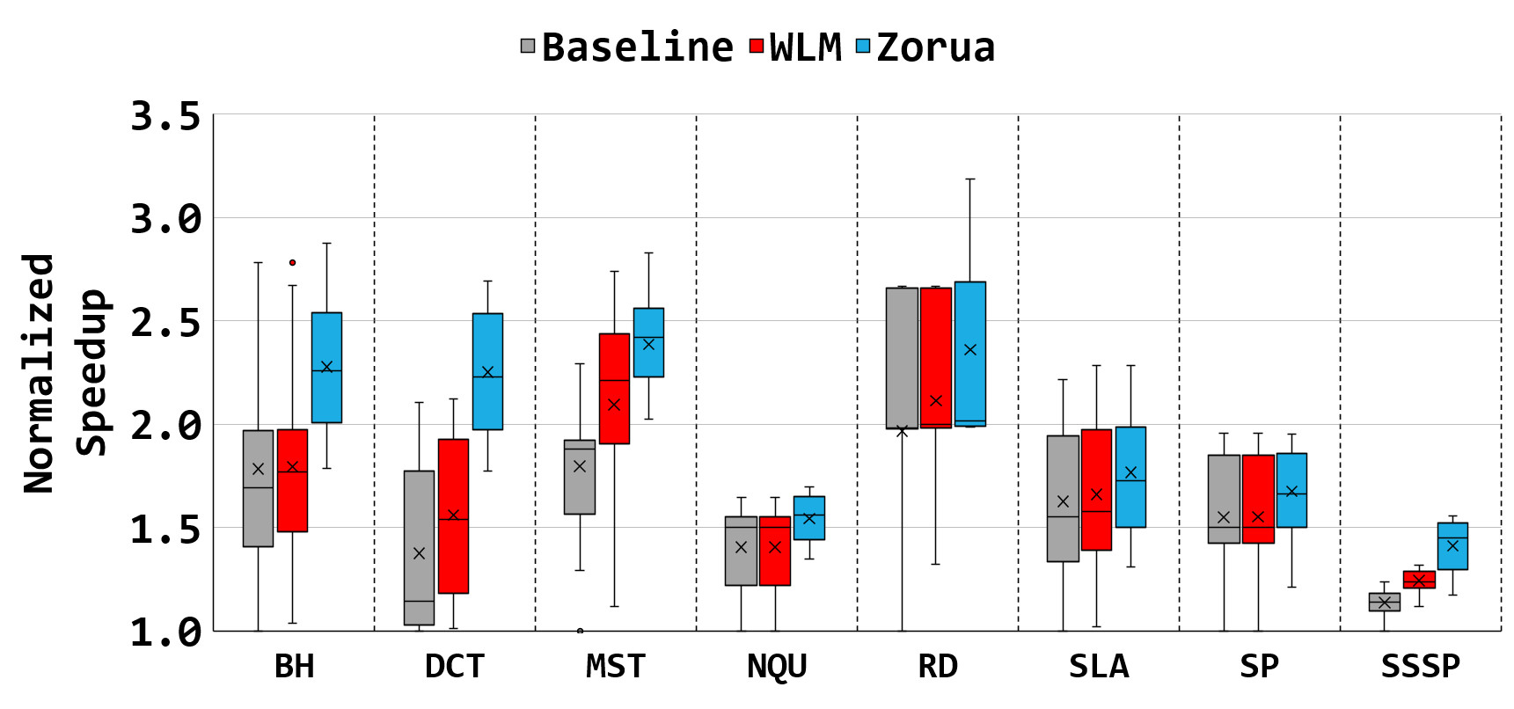
Effect on Performance Variation
Baseline
WLM
Zorua
Zorua reduces the dependence of performance on resource specification
Maximum
Upper Quartile
Performance variation across different specification points
Average
Lower Quartile
Minimum
* Xiang et al., HPCA ‘14

Slide 34
Effect on Performance Cliffs
Zorua alleviates the performance cliffs resulting from un-optimized specifications
MST
NQU

Slide 35
Effect on Performance Portability
Zorua reduces the performance loss from porting across GPU architectures
53%
24%

Slide 36
Other Uses
Resource sharing in multi-programmed environments
Low latency preemption of kernels
Dynamic parallelism
…

Slide 37
Conclusion
Problem: The tight coupling between programmer-specified resource usage and allocation of on-chip resources leads to challenges in:
programming ease, performance portability, resource efficiency
Our Approach: Decouple specification and management of on-chip resources
Our Solution: Zorua: A holistic approach to virtualizing multiple on-chip resources in GPUs
Key Results:
Zorua reduces dependence of performance on programmer-specified resource usage
Zorua enhances programming ease and performance portability
Zorua improves performance with more efficient resource utilization
Future Work: Zorua enables several other use cases

Slide 38
Zorua: A Holistic Approach to Resource Virtualization in GPUs
Nandita Vijaykumar
Kevin Hsieh, Gennady Pekhimenko, Samira Khan,
Ashish Shrestha, Saugata Ghose, Adwait Jog, Phillip B. Gibbons, Onur Mutlu

Slide 40
A Walkthrough
Coordinator
Warp
Scheduler
Acquire
resources
Thread
Block
Scheduler
Thread
queue
Scratchpad
queue
Register
queue
Register Mapping Table
Scratchpad Mapping Table
Thread Mapping Table
Release
resources

Slide 41
Effect on schedulable warps

Slide 42
Effect on energy consumption

Slide 43
Summary of applications

